Slide 1

Crimmigration 101
Ronald P. Mondello, Esq.
Immigration and Criminal Attorney
0-100 27th Street
Fair Lawn, N.J. 07410
(201) 703-9400
www.njcrimmigration.com

Slide 2

CRIMINAL
IMMIGRATION
MUNICIPAL
POST CONVICTION RELIEF

Slide 3
Immigration Statuses
US Citizen
Lawful Permanent Resident (Green Card)
Temporary visitors (visitors, student)
EWI
DACA
Deferred Action Status
There are over 60 different kinds of visas

Slide 4
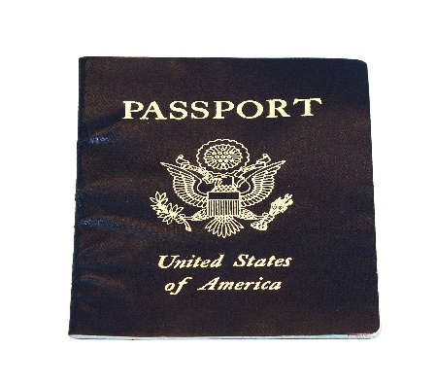
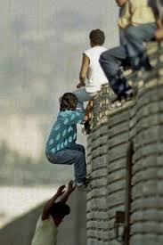




Determining
Status
VS.

Slide 5
Inadmissibility
A Legal Fiction – mere physical presence in the U.S. does not mean that the FN lawfully entered or was admitted to the U.S.
You had to have been inspected and authorized by an immigration officer to be admitted therefore YOU HAVE NOT BEEN ADMITTED EVEN THOUGH YOU ARE HERE!
INA § 212 – Grounds of inadmissibility

Slide 6
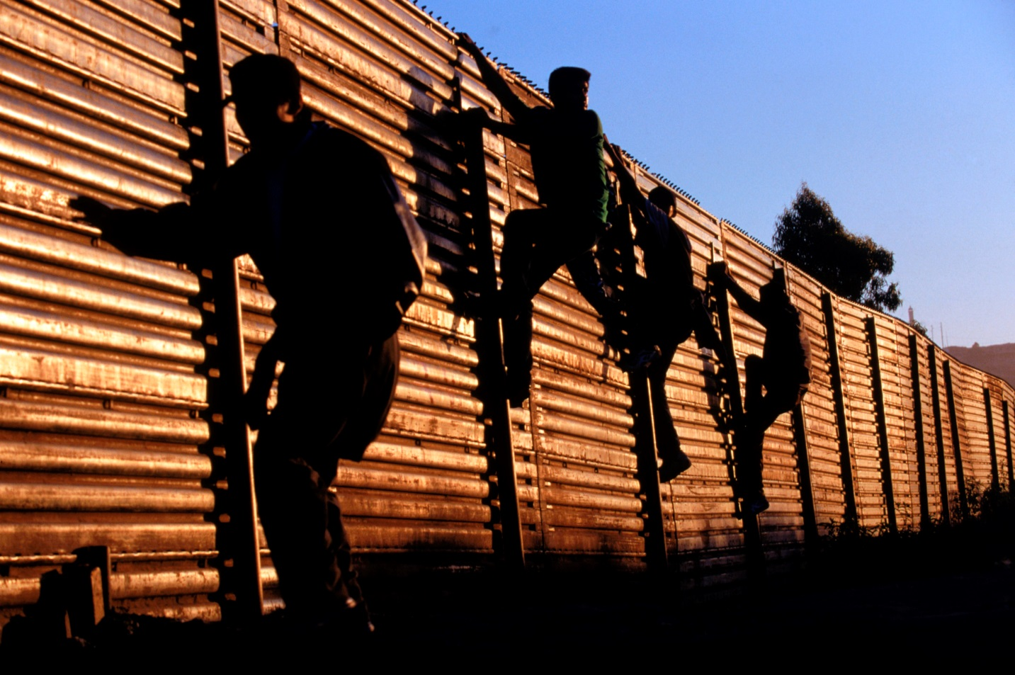
Entry without Inspection
EWI/No Inspection
Notes:
The FN defendants who snuck in are subject to the grounds of inadmissibility.

Slide 7

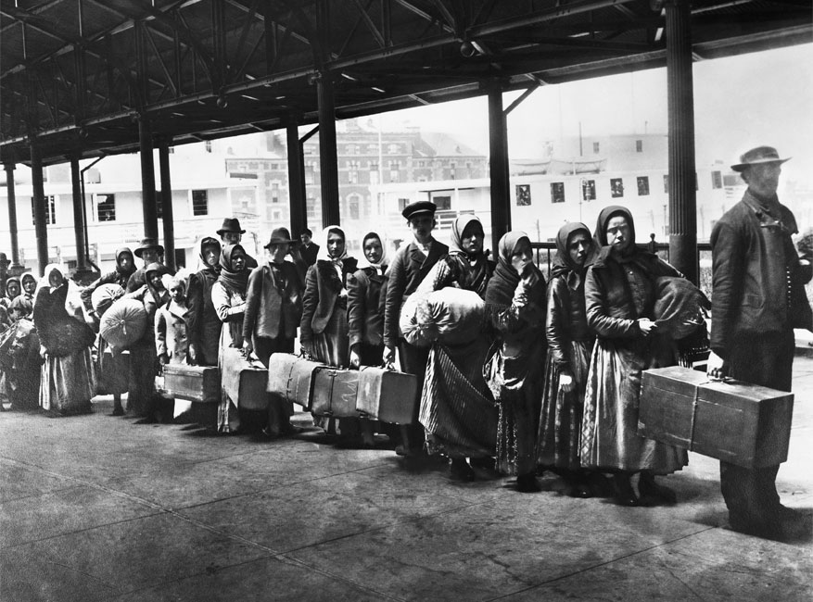
INADMISSIBILITY

Slide 8
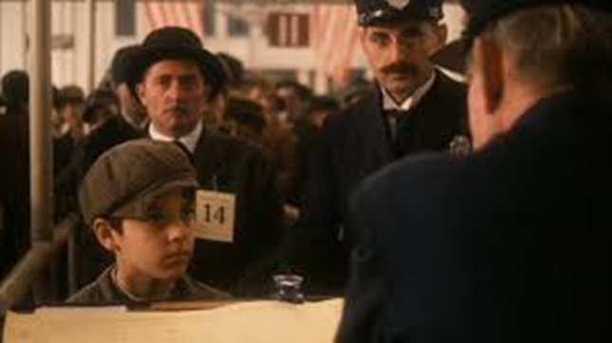
INADMISSIBILITY

Slide 9
Deportability
A FN has been lawfully admitted to the U.S. and then commits a crime
INA § 237 – Grounds of Deportability
Notes:
A FN criminal defendant came here legally and gets arrested and pleads guilty to the NJ criminal charge. He is facing grounds of deportability.

Slide 10
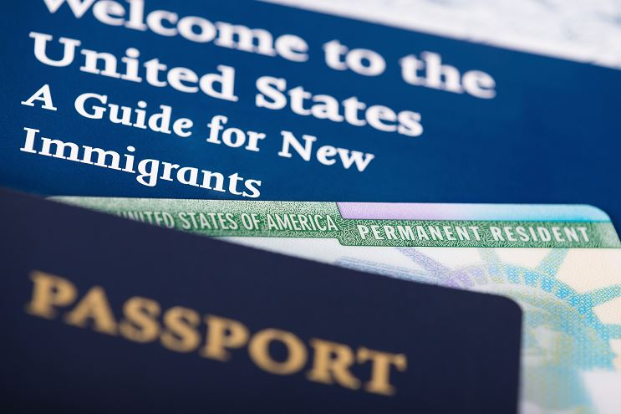
DEPORTABILITY

Slide 11
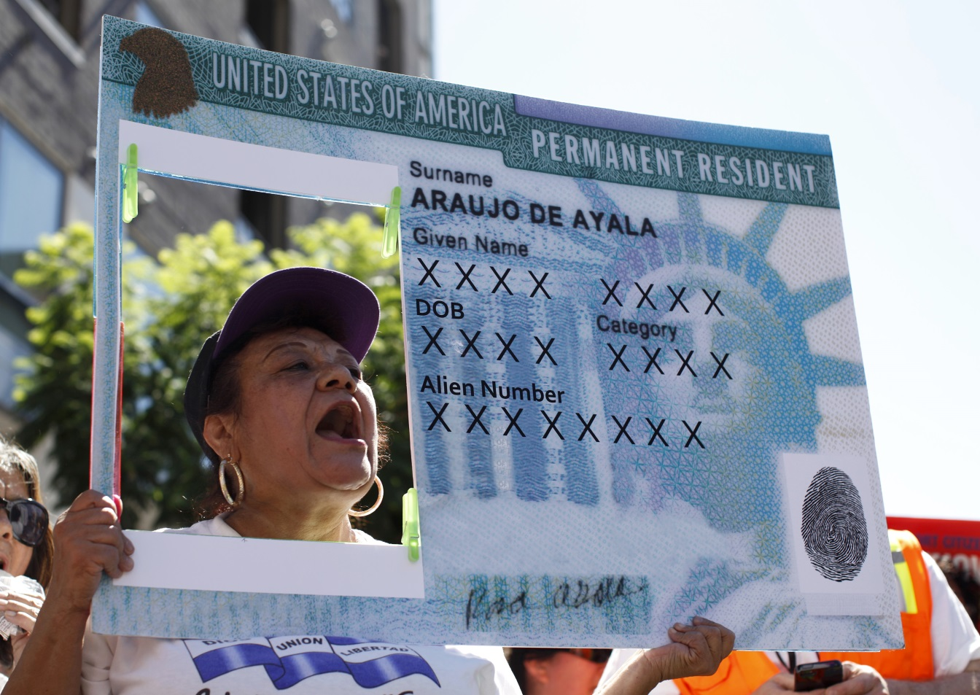
Lawful Permanent Resident
Green Card/Inspected

Slide 12
Why does an attorney have to know that?
Different immigration consequences between criminal grounds of inadmissibility and deportability.
For example:
A NJ criminal conviction may not have the same effect on a green card holder versus an EWI
A NJ criminal conviction may only effect a green card holder if he leaves the country and returns
Notes:
LPR - After a green card holder has been here for 5 years, he pleads to a NON-AF NJSA 2C: 20-3 Theft. Third degree. It is a CIMT not an AF. He has no priors. He is OK.
EWI - The same exact offense, same time frame for an EWI…he gets put in deportation or removal proceedings.
LPR – The same green card holder goes to Italy and returns at JFK to be inspected by CBP – he is now subject to grounds of inadmissibility and will be put in deportation.

Slide 13
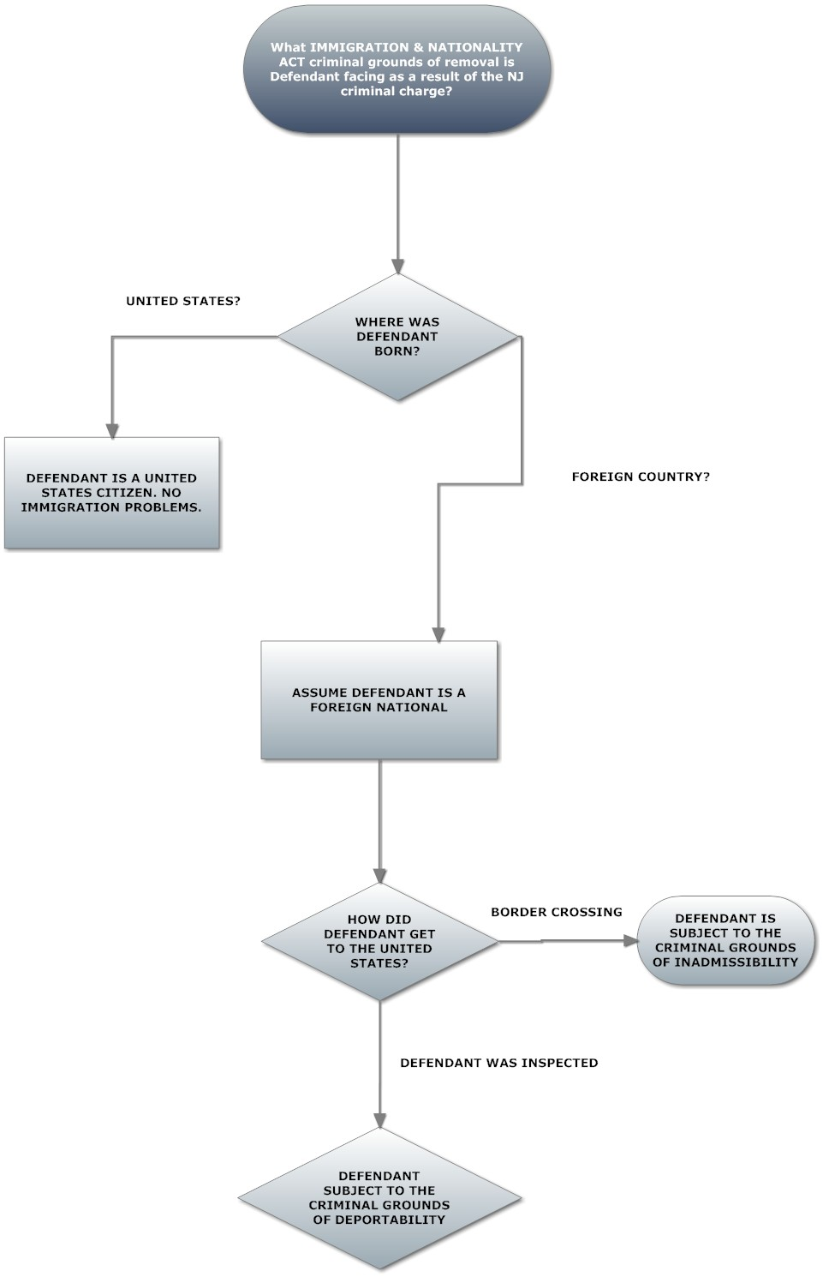
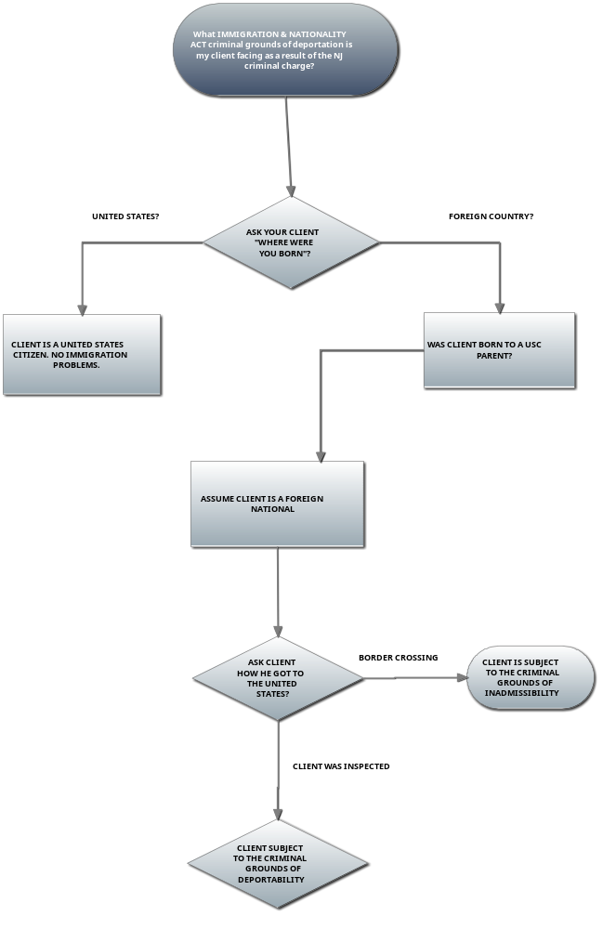

Slide 14
Examples
Inadmissible or Deportable?
Mexican FN here for 10 years. Got here via “Coyote”. If he gets pulled over for DWI; coke in the car and ICE shows up, he is ?
Polish FN gets here with a B-2 visitor visa. It expires in 6 months. He gets busted for only simple possession of pot. ICE shows up, he is ?
Italian FN with a green card has a criminal conviction for theft. He travels to another country for vacation. When he returns to JFK, he is ?

Slide 15
Inadmissibility v. Deportability
Criminal Grounds
Inadmissibility
INA § 212(a)(2)
Deportability
INA § 237(a)(2)
Conviction or admitted commission of any controlled substance offense
Conviction or admitted commission of a crime involving moral turpitude (subject to a one-time petty offense exception)
Conviction of two or more offenses of any type with aggregate sentences to imprisonment of at least five years
Reason to believe Prostitution and commercialized vice
Reason to believe (RTB) drug dealer
(RTB) Human Trafficking
(RTB) Money Laundering
Conviction of any controlled substance offense (other than a single offense of simple possession of 30 grams or less of marijuana)
Conviction of a crime involving moral turpitude (“CIMT”), committed within five years of admission to the United States and punishable by a year in prison
Conviction of two crimes involving moral turpitude committed at any time and regardless of actual or potential sentence.
Conviction of a firearm or destructive device offense
Conviction of a crime of domestic violence, stalking, child abuse, child neglect, or child abandonment, violation of an order of protection, whether issued by a civil or criminal court.
Human Trafficking/Espionage/Treason
Failure to Register as a Sex Offender
Conviction of an aggravated felony as defined in INA § 101(a)(43)
Notes:
What happens to the EWI who gets busted for a joint? Possession of marijuana for one’s own personal use is NOT a CIMT. What happens if he has a green card? What happens to the green card holder if she has 2 DP shoplifting offense? What happens if she has one? Examples under Deportability: Loitering to obtain coke or heroin. 4th degree or higher theft. Like a Title 9 violation. TRO or FRO.

Slide 16
Petty Offense Exceptions for Inadmissible FN Convicted of CIMT’s
Maximum sentence possible does NOT exceed one year; AND
You are NOT sentenced in excess of six months
Regardless of actual time spent in jail
Suspended sentence = Sentence
Notes:
POE – these are all of our CIMT DP’s like Shoplifting and theft.

Slide 17
Inadmissibility v. Deportability
Criminal Grounds
Inadmissibility
INA § 212(a)(2)
Deportability
INA § 237(a)(2)
Conviction or admitted commission of any controlled substance offense
Conviction or admitted commission of a crime involving moral turpitude (subject to a one-time petty offense exception)
Conviction of two or more offenses of any type with aggregate sentences to imprisonment of at least five years
Reason to believe Prostitution and commercialized vice
Reason to believe (RTB) drug dealer
(RTB) Human Trafficking
(RTB) Money Laundering
Conviction of any controlled substance offense (other than a single offense of simple possession of 30 grams or less of marijuana)
Conviction of a crime involving moral turpitude (“CIMT”), committed within five years of admission to the United States and punishable by a year in prison
Conviction of two crimes involving moral turpitude committed at any time and regardless of actual or potential sentence.
Conviction of a firearm or destructive device offense
Conviction of a crime of domestic violence, stalking, child abuse, child neglect, or child abandonment, violation of an order of protection, whether issued by a civil or criminal court.
Human Trafficking/Espionage/Treason
Failure to Register as a Sex Offender
Conviction of an aggravated felony as defined in INA § 101(a)(43)
Notes:
What happens to the EWI who gets busted for a joint? Possession of marijuana for one’s own personal use is NOT a CIMT. What happens if he has a green card? What happens to the green card holder if she has 2 DP shoplifting offense? What happens if she has one? Examples under Deportability: Loitering to obtain coke or heroin. 4th degree or higher theft. Like a Title 9 violation. TRO or FRO.

Slide 18
“Get Out of Deportation Card” for Deportable FN Convicted of CIMT’s
Any Indictable CIMT committed AFTER five years of LAWFUL ADMISSION then one free CIMT crime
HOWEVER: Not applicable to AF’s
Notes:
So green card holders get one free indictable CIMT AFTER 5 years of the green card being in their pocket. If you commit 2 CIMT’s you are subject to deportation. No free AF’s.

Slide 19
Specific Issues in NJ Municipal Court
N.J.S.A. 2C:35-10c - Possession, Use or Being Under the Influence, or Failure to Make Lawful Disposition. Failure to turn over or under the influence. Drug is coke. DP, no problem. Right? WRONG!
§36 Conditional Discharge – If Defendant makes a statement of possession in order to exculpate his girlfriend. IJ will request transcript.
N.J.S.A. 2C:36-2 – Drug Paraphernalia. The main lesson of Mellouli v. Lynch is that if a state punishes people for more types of drugs than federal law, then a drug paraphernalia conviction does not automatically trigger removal. This offense can be problematic.
N.J.S.A. 2C:33-2.1 – Loitering. Not a good deal for FN. They lose out on a potential waiver (30 grams or less of pot). Loitering for WHAT?
N.J.S.A. 2C:20-11 – Shoplifting. CIMT. SAFE HAVEN = N.J.S.A. 2C:33-2A(1) Disorderly Conduct. Neutral factual basis. I was in Hackensack and created a disturbance.
Prostitution has VERY serious immigration consequences.
Borough Ordinances - Think it is ALWAYS a safe bet? THINK AGAIN…

Slide 20
Definition of Conviction
Immigration and Nationality Act (INA) defines a “conviction” as:
formal judgment of guilt of the alien entered by a court or, if adjudication of guilt has been withheld, where-
(i) a judge or jury has found the alien guilty or the alien has entered a plea of guilty or nolo contendere or has admitted sufficient facts to warrant a finding of guilt, and
(ii) the judge has ordered some form of punishment, penalty, or restraint on the alien's liberty to be imposed. (INA § 101(a)(48))
Notes:
Guilty Plea or no plea but with a factual basis (CD) plus any form of punishment. Is a Conditional Dismissal a conviction for immigration purposes? How about a conditional discharge? How about if I say that the defendant admitted that the drugs were his and not his girlfriend who was also charged? How about the example of simple possession of cocaine downgraded to loitering and the prosecutor asks “and you actually obtained and possessed the cocaine?”

Slide 21
What does that mean for New Jersey “convictions”?
Only a finality of conviction counts (all times for all direct appeals have expired)
PCR is collateral. The filing does not change the finality of the conviction
Any PTI, Conditional Dismissal, or Conditional Discharge with a PLEA is a conviction (IJ will ask for plea transcript)
Drug Court requires a PLEA – conviction!
Juvenile Delinquency Adjudication is not a conviction (DON’T waive up)

Slide 22

EXPUNGEMENTS =

Slide 23

EXPUNGEMENTS =

Slide 24
EXPUNGEMENTS + PCR =

Slide 25
State v. Lopez, Not Reported in A.3d (2012) 2012 WL 5372118
Post-Conviction Relief (PCR) Petition
In 2011, Lopez filed a PCR petition claiming ineffective assistance of counsel regarding immigration consequences of his guilty plea. ​
The Criminal Division manager refused to accept the petition due to the expungement, prompting Lopez to seek to vacate the expungement order. ​
Court's Decision
The trial court allowed Lopez access to his expunged records and permitted the filing of his PCR petition without vacating the expungement. ​
The court relied on N.J.S.A. ​ 2C 52–19, which allows inspection of expunged records for judicial proceedings. ​
Legal Implications
The court did not decide whether Lopez could vacate the expungement order, as it was not necessary for his PCR petition.
The case raises questions about the statutory framework governing expungement and the rights of individuals facing deportation due to criminal convictions. ​

Slide 26
State v. QUAMMIE, Trial Court (Monmouth County - Judge Guadagno, J.A.D. (ret.& t/a)
The expungement issue in this case revolves around whether a defendant, whose marijuana conviction was automatically expunged under New Jersey's Cannabis Regulatory, Enforcement Assistance, and Marketplace Modernization Act (CREAMMA), can vacate that expungement to challenge the underlying conviction through a petition for post-conviction relief (PCR). ​
Key points regarding the expungement issue:
Automatic Expungement Under CREAMMA: CREAMMA mandated the automatic expungement of certain marijuana-related convictions to address the adverse consequences of such offenses. ​ This expungement occurred "by operation of law," without requiring individuals to take any action. ​
Defendant's Situation: The defendant, Matthew J. Quammie, sought to vacate his expungement to challenge his 2016 marijuana conviction, arguing that his plea counsel failed to properly advise him of the immigration consequences of his guilty plea. ​ The expungement initially prevented him from filing a PCR petition. ​
Legislative Intent and Statutory Limitations: The court noted that the expungement statute does not explicitly provide a mechanism for vacating a valid expungement order, except in cases of statutory disqualification at the time of the initial expungement. ​ However, the court acknowledged that the Legislature likely did not anticipate situations like this, where a defendant would seek to vacate an expungement to pursue PCR. ​
Judicial Interpretation: The court referenced prior cases and directives, including State v. Lopez and AOC Directive #25-21, which suggest that expungements may be vacated under certain circumstances. ​ However, these provisions primarily address motions by the State, not defendants. ​

Slide 27
State v. QUAMMIE, Trial Court (Monmouth County -
Judge Guadagno, J.A.D. (ret.& t/a) April 30, 2025
Court's Decision: Despite the lack of explicit statutory authority, the court treated the order vacating the expungement as valid for the purpose of considering the defendant's PCR petition. ​ The court reasoned that barring PCR relief due to automatic expungement would contradict the legislative intent of CREAMMA, which aimed to alleviate the consequences of marijuana convictions. ​
In summary, the expungement issue highlights the tension between the automatic expungement provisions of CREAMMA and the need to allow defendants to challenge their convictions when such convictions have significant collateral consequences, such as deportation. ​ The court ultimately prioritized the interests of justice and treated the vacated expungement as valid to address the defendant's claims. ​

Slide 28
Chief Justice Stuart Rabner/Directive #07-19/Immigration-Related Policies: Revisions to Judiciary Forms; Updated Attorney General Guidance; Court Involvement with ICE Activities/May 23, 2019
Immigration-Related Policies
Judiciary will only collect immigration status information when necessary for court purposes.
Non-speciﬁc collection of immigration data is discontinued.
Attorneys, not judges, are responsible for raising immigration status issues in court.
ICE Activities at Courthouses
Courthouses are to be treated as sensitive locations, minimizing ICE enforcement actions.
ICE should identify themselves to courthouse security and display warrants.
Arrests should occur only after court events in non-public areas.
Judges and court staff cannot impede ICE enforcement actions.

Slide 29
Civil immigration enforcement actions in or near courthouses are permitted under the following limited circumstances:
National Security Threat: The action involves a national security threat.
Imminent Risk of Harm: There is an imminent risk of death, violence, or physical harm to any person.
Hot Pursuit: The action involves hot pursuit of an individual who poses a threat to public safety.
Imminent Risk of Evidence Destruction: There is an imminent risk of destruction of evidence material to a criminal case.
Additionally, in the absence of hot pursuit, enforcement actions against individuals posing a threat to public safety may be taken if:
  A safe alternative location for the action does not exist or is too difficult to achieve.
  The action is approved in advance by a Field Office Director, Special Agent in Charge, Chief Patrol Agent, or Port Director.
To minimize impact, enforcement actions in courthouses should be conducted in non-public areas, in collaboration with courthouse security, and at the conclusion of judicial proceedings.

Slide 30
ICE's courthouse arrest policy escalates tensions with state courts effectiveness
ICE's Courthouse Arrest Policy
Federal law enforcement arrests Wisconsin judge for allegedly obstructing an immigration arrest at her courthouse.
Policy changes under the Trump administration increased ICE arrests in courthouses, leading to conﬂicts with state courts.
In 2017, ICE arrests in New York courthouses rose from 11 to 159 and 178 in 2016 and 2017-2018, respectively.
Impact on Community Safety
Increased ICE presence in courthouses has deterred victims from seeking legal protection, particularly in domestic violence cases.
Reports of domestic violence cases dropped signiﬁcantly in cities like Los Angeles and San Diego during 2017-2018.
A group of 75 retired judges expressed that courthouse arrests compromise the justice system's effectiveness.
Response from Judicial System
The Biden administration limited courthouse arrests in response to concerns, contrasting with the Trump administration's directive to increase enforcement.
Local prosecutors and judges have called for keeping immigration enforcement out of courthouses to ensure judicial duties can be performed effectively.
Massachusetts judge faced similar allegations in 2019 but was not arrested, highlighting the contentious nature of these cases.

Slide 31
The defendant will be asking you for these items for immigration
Original or Certified Copies of:
Arrest Report
Complaint
Summons
Plea Sheet
Court Disposition
Proof of Conditional Dismissal or Conditional Discharge
Transcript of the Plea
If no original records:
A statement from the municipal court administrator indicating that the records are not available and why they are not available.
It must also state whether records from the relevant time are generally available or are not generally available.

Slide 32
ICE IN IMMIGRATION COURTS
Since mid-May 2025, ICE has resumed arresting noncitizens at immigration court hearings—first targeting individuals whose cases were dismissed and now expanding to those with pending cases. ICE and the immigration court system (EOIR) are working in tandem to fast-track deportations and sidestep due process.

Slide 33
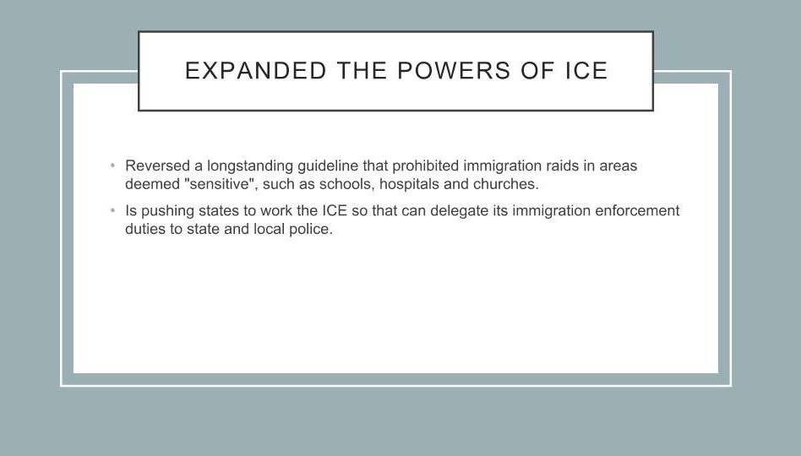

Slide 34
Laken Riley and Detention
New law expands mandatory detention to include certain undocumented people who have been charged, arrested, or convicted of theft offenses, including shoplifting
**Mandatory detention = no bond**
Also allows state governments to bring lawsuit in immigration decisions: both policy and individual cases
Unclear how it will play out in practice and retroactivity issues

Slide 35
Obligations of a prosecutor under AG’s Trust Directive
NO ONE DOES THIS! Leave it to the Judge…
Post-Conviction Relief in the Wake of Padilla

Slide 36
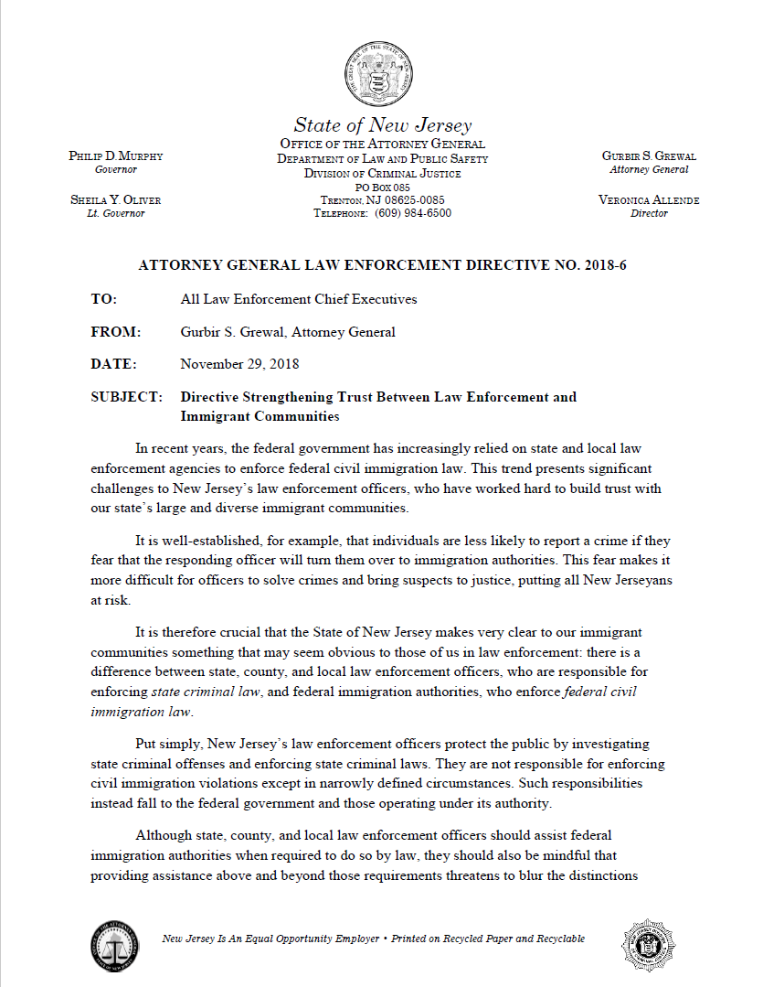

Slide 37
What are the Prosecutor’s Obligations NOW?
V. Considerations for Prosecutors
A. Initial court appearances. At a defendant’s initial court appearance before a judge, the prosecutor shall confirm that the defendant has been advised on the record that:
1. Potential charges and convictions may carry immigration
consequences, see Padilla v. Kentucky, 559 U.S. 356 (2010)
D. Charging, resolving, and sentencing cases. As in all cases, the prosecutor should be mindful of potential collateral consequences and consider such consequences in attempting to reach a just resolution of the case. Nothing in this Directive shall be construed to require any particular charge or sentence, to limit prosecutorial discretion in reaching a just resolution of the case, or to prevent the prosecutor from making any argument at sentencing.

Slide 38
What are the Judge’s Obligations in the Wake of Padilla
Municipal Court Judges
  Directive #09-11
Superior Court Judges
  Question 17
  the immigration consequences of a guilty plea in Directive #14-08, Directive #08-09, and Directive #05-11
  Directive #05-11 explained that "Question 17 is designed to ensure that defendants understand that they have an opportunity to seek consultation with an attorney about the immigration consequences of a plea, should they choose to do so. However, there is no obligation to provide defendant with separate counsel for this purpose. Judges should be guided accordingly when addressing these matters."

Slide 39
Obligations of a municipal court practitioner under Padilla v. Kentucky
Post-Conviction Relief in the Wake of Padilla

Slide 40
Padilla v. Kentucky
Requires criminal and municipal court defense attorneys to advise as to the risks of deportation
When the immigration law consequences are easy obtained, municipal court attorneys must advise client
When the immigration consequences are complex the duty to advise is more limited
Complex = duty is to advise charges MAY carry a risk of adverse immigration consequences
Clear = duty to give correct advice
Prior to Padilla, if you said nothing no IAC. If you gave wrong advice, then IAC. Court recognized prior to Padilla the law was encouraging criminal defense attorneys to say nothing
After Padilla, you MUST give some form of advice
When an undocumented Defendant has a shoplifting CHARGE OR CONVICTION, Defense Counsel MUST tell the Defendant that he/she is subject to mandatory deportation (Laken Riley law).

Slide 41
Entry without Inspection
EWI/No Inspection
Notes:
Here are 4 EWI’s. Later on you we will discuss EWI’s with DWI’s.

Slide 42

ewi defendant charged with a dwi

Slide 43

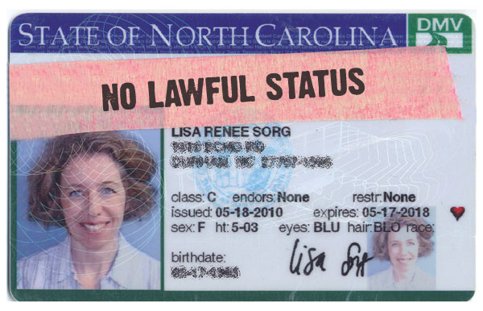
EWI’S with dwi’s
DWI or DUI
  ICE is looking for DWI EWI defendant!
  ICE is obtaining the names of foreign nationals charged with DWI
  ICE is showing up at municipal court…waiting
  Refusal appears to be OK (at least for now)

Slide 44
WHO IS SAFE FROM A DWI?
LPR – H.R. 875??
EWI – ABSOLUTE DANGER!!!!
F1 Student – Discretionary DANGER!!!!
B1/B2 Visitor – Discretionary DANGER!!!!
H1B – Discretionary DANGER!!!!

Slide 45
Crimes Involving Moral Turpitude
The phrase “moral turpitude” is one of the most ambiguous in the long list of ambiguous legal phrases and the cases are far from consistent.
Moral turpitude refers to conduct that is inherently base, vile, or depraved, contrary to the accepted rules of morality and the duties owed other persons, either individually or to society in general.
In determining whether an offense involves moral turpitude, it is a common mistake to consider whether the crime is a DP or a “degree” crime. Intentional theft of a piece of bubble gum is theft and involves moral turpitude.
The facts of your clients case does not determine whether an offense involves moral turpitude. If they did, immigration judges would be charged with retrying the criminal case in immigration court.
The focus is on whether the elements necessary to obtain a conviction under a particular NJ Criminal Statute render the offense a crime involving moral turpitude.
Generally need a specific intent to do harm, or knowledge of the act’s illegality. Recklessness might be enough. Negligence is not moral turpitude.
Notes:
The term is ambiguous. There has to be some base or vile conduct. Forget severity of the crime. Steal a piece of gum. DP’s can be CIMT’s. Look to the elements of the NJ statute not the facts of the case. READ Generally…

Slide 46
Crimes involving moral turpitude
Discussion of Specific NJ Offenses and Whether they are CIMTs:
- Theft when a permanent taking is intended (not joyriding)
2C:20-11 Shoplifting
- Burglary – CIMT if you are there to steal not watch TV or sleep
- Fraud - need intent to defraud or guilty knowledge
2C:21-5 Bad Checks (intent to defraud is an element)
2C:21-2.1(c) False Documents (intent to defraud is not an element)
- Crimes of violence (bodily harm is intentionally or knowingly caused or threatened)
- Most sex offenses
- DWI plus an aggravating factor like a 39:3-40 where defendant knew his license was suspended (knowledge)
- CDS (generally not a CIMT but drug dealing is)
- Firearms (standing alone, not a CIMT but a separate ground of deportability)

Slide 47
Aggravated Felonies
Definition found in INA §101(a)(43)
Generally, no relief available to FN
Three categories:
(1) Offenses that are AF by their very nature
(2) Offenses that are AF based on monetary amounts or loss to victim
(3) Offenses that are AF based upon sentence
Notes:
A guilty plea to an aggravated felony is the equvilient to a life time prison sentence back to their home country.

Slide 48
Aggravated Felonies
Nature of the Offense
Murder, rape, or sexual abuse of a minor
Drug trafficking
Firearms trafficking (including destructive devices)
Prostitution business
Human trafficking
Kidnapping
Child Pornography (Salmoran 3rd Circuit said nope but it is Child Abuse)

Slide 49
Aggravated Felonies
Monetary Amounts
Money laundering involving funds in excess of
$10,000
Fraud or deceit where loss to the victim
exceeds $10,000
Tax evasion where loss to the Government
exceeds $10,000

Slide 50
Aggravated Felonies
Sentence imposed is at least one year
Theft
Burglary (NJ statute too broad – car and disorderly conduct)
Crime of violence (what is that? – next slide)
Possession of stolen property
U.S. Passport Fraud
Commercial bribery, counterfeiting, forgery, or trafficking in vehicles
Obstruction of justice, perjury or subornation of perjury, or bribery of a witness
Bail Jumping (2C:29-7 – third degree only b/c potential sentence must be 5 years or more)

Slide 51
Crime of Violence at 18 USC § 16
VOID FOR VAGUENESS!
18 USC § 16a – An offense that has as an element the use, attempted use, or threatened use of physical force against a person or property.
18 USC § 16b – Any other offense that is a felony and that, by its nature, involves a substantial risk that physical force against the person or property of another maybe used in the course of committing the offense.
Look to the mens rea – Purposeful v. Negligence
Specific Intent to Harm v. Thoughtless or Careless Action. More than 364-day jail sentenced required.
Notes:
First Degree murder would be a crime of violence. Negligence in clowning around driving down the wrong side of the street at 4am with no other cars on the road and accidently striking another vehicle would not be a COV. Reckless might be. An awareness and conscious disregard of the risk. Federal Courts across the country struggle with whether recklessness is a COV or not. Criminal negligence – Failure to perceive a risk. An eluding offense has the potential to be a COV. Burglary, by its nature, involves a substantial risk that the burglar will use forces against a victim in completing the crime. Someone applying for a green card could be denied for any form of DV, including one that is not a COV. Discretionary on the part of the immigration officer.

Slide 52
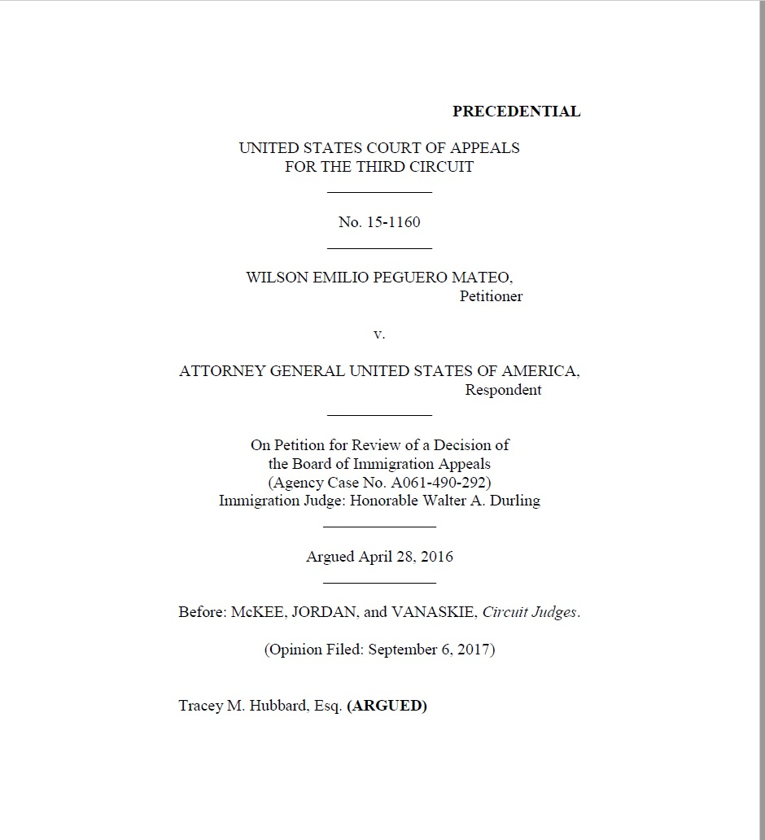
The Court concluded that “[b]y combining indeterminacy about how to measure the risk posed by a crime with indeterminacy about how much risk it takes for the crime to qualify as a violent felony, the residual clause produces more unpredictability and arbitrariness than the Due Process Clause tolerates.”

Slide 53
DV/Child Abuse/DWI
Inadmissible
Deportable
  “significant misdemeanor” like DV or DWI (but you said petty offense exception?)
  Our DP DV’s and our DWI’s can result in deportation for EWI Defendants (policy v. law)
  Conditional Dismissal is unavailable for DV
  Even if it was…NO GOOD! Why?
  The arrest on CCH is “labeled” Domestic Violence
DV – must be a “Crime of Violence” at 18 USC § 16a (not at 18 USC § 16b)
Violation of Restraining Order
Child Abuse – generally, almost any act or omission with any mens rea (including criminal negligence) that qualifies as maltreatment, and harms a minor’s mental or physical well-being with an actual injury. However, 10th Circuit says mens rea of negligence is no good. 2nd Circuit says actual injury not required.
Generally No issues with DWI’s (USC)
NOW DUI’s for CDS = deportable

Slide 54
Controlled Substance Violations
Not all drugs are controlled substances
Illegal possession of cancer drugs from Haiti is a crime but not a “controlled substance” violation
Must be listed on the federal schedule (21 USC § 802) otherwise not a controlled substance
CSV are independent grounds of inadmissibility and deportability
Do not need a conviction – or even an arrest – on his record. “Reason to believe” he is a drug dealer is sufficient to be denied admission to the U.S.
Green Card holder returning from abroad = convicted or admits = denied
Simple possession of Ruffies flu·ni·tra·ze·pam is AF

Slide 55
NJ AF Crimes Defense Counsel will BEG you to AMEND
NJSA 2C:24-4(a) - Endangering the welfare of a child. Any kind of sexual abuse of a minor case
NJSA 2C:12-1(b) - Aggravated assault
jail => one year
NJSA 2C:20-et. seq. Theft
jail => one year
NJSA 2C:18-2 Burglary of a dwelling to steal
jail => one year
NJSA 2C:35-5 Possession with intent to distribute a CDS
Possession of any CDS listed on the Federal schedule other than marijuana (cocaine, heroin, pills)

Slide 56
SAFE HAVENS FROM SAM
WITH MEGAN’S LAW AND/OR PSL
NJSA 2C:24-4(a) - Endangering the welfare of a child (eliminate the “sexual conduct”. Consider Title 9? Although Title 9 is not specifically mentioned in 2C:7-2b(2), see 2C:7-2b(3). [other NJ offenses similar to Megan’s Law offenses]; see Footnote 2 In re R.B., 376 N.J.Super. 451. Court says argument can be made that Title 9 is “similar to” Megan’s Law enumerated offenses.
Aggravated Sexual Assault and Sexual Assault. Don’t specify which section. Put in the Indictment or Accusation No Age element. But keep Megan’s Law and PSL.
Criminal Sexual Contact. ELIMINATE THE AGE ELEMENT BUT KEEP MEGANS LAW AND PSL. Criminal Sexual Contact and Aggravated Sexual Contact relate back to 2C:7-2b(2) predicate offense aggravated sexual assault and sexual assault.

Slide 57
OTHER SAFE HAVENS FROM AF’s
N.J.S.A. 2C:35-5(b) possession with intent to distribute any controlled substance: amend to 2C:35-7 School Zone but use near a bus.
Reduce Jail sentence to 364 days
Reduce Monetary loss to < $10,001
Resisting Arrest – no injuries
Objection of Justice – no fraud or false information
Eluding (Third Degree ONLY)
Notes:
The crimes might still be CIMT’s but at least you eliminated the AF classification. NJSA 2C:35-7 distribution in a school zone. In NJ it includes near or on a bus.

Slide 58
Specific Issues in Remand Court
N.J.S.A. 2C:35-10c - Possession, Use or Being Under the Influence, or Failure to Make Lawful Disposition. Failure to turn over or under the influence. Drug is coke. DP, no problem. Right? WRONG! SAFE HAVEN = N.J.S.A. 2C:35-10a(4) POT- 30 grams or less.
§36 Conditional Discharge – If Defendant makes a statement of possession in order to exculpate his girlfriend. IJ will request transcript.
N.J.S.A. 2C:36-2 – Drug Paraphernalia. “Relating to” a controlled substance violation. A Crack pipe is a BIG PROBLEM.
N.J.S.A. 2C:33-2.1 – Loitering. Not a good deal for FN. They lose out on a potential waiver (30 grams or less of pot). Loitering for WHAT?
N.J.S.A. 2C:20-11 – Shoplifting. CIMT. SAFE HAVEN = N.J.S.A. 2C:33-2A(1) Disorderly Conduct. Neutral factual basis. I was in Hackensack and created a disturbance.

Slide 59
WHO IS SAFE FROM A DWI?
LPR – SAFE
EWI – ABSOLUTE DANGER!!!!
F1 Student – Discretionary DANGER!!!!
B1/B2 Visitor – Discretionary DANGER!!!!
H1B – Discretionary DANGER!!!!

Slide 60
WHO IS SAFE FROM A DWI?
LPR – maybe DANGER!!!!
EWI – ABSOLUTE DANGER!!!!
F1 Student – ABSOLUTE DANGER!!!!
B1/B2 Visitor – ABSOLUTE DANGER!!!!
H1B – ABSOLUTE DANGER!!!!

Slide 61
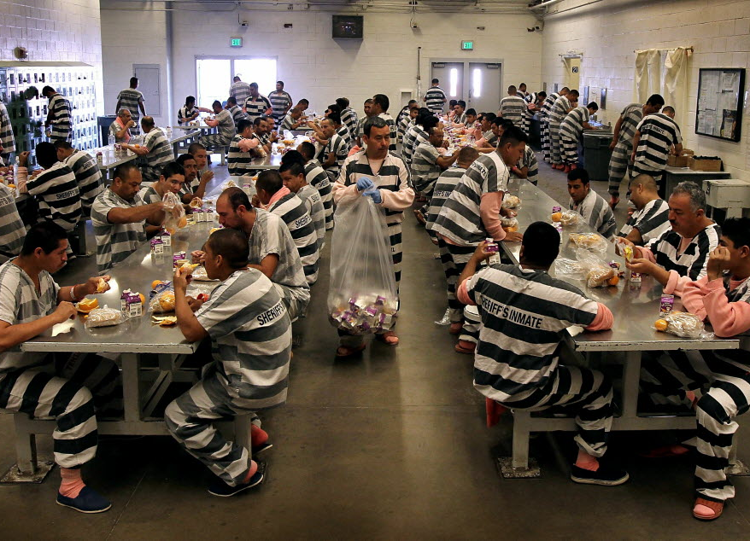
FN Defendant is in the County Jail with an ICE Detainer

Slide 62
ICE DETAINER
After an alien is taken into state custody, DHS places a notice with state prison officials requesting the Bureau of Prisons or state equivalent to notify DHS if they intend to release the detained alien or hold the alien for DHS.
Pursuant to 8 CFR 236.1, 287.7, 1236.1, state officials can only hold aliens for 48 hours based on DHS detainer request
Immigration Bonds
  DHS and EOIR (Executive Office of Immigration Review) typically refer to “bail” as “bond”
  Immigration Bonds cannot be paid with cash or by personal check and the usual 10% rule that is common in the criminal context is generally not applicable
Decision to Detain
  Immigration must make a decision within 48 hours of arrest, or in the case of an emergency, a reasonable period of time. See 8 CFR 287.3(d)

Slide 63
Mandatory Detention: INA § 236(c)
Noncitizens who have committed certain offenses must be detained, without bail, by U.S. Immigration and Customs Enforcement (USICE) during the pendency of their removal proceedings
We conclude that 8 C.R.F. § 287.7 does not compel state or local LEAs to detain suspected aliens subject to removal pending release to immigration officials. Section 287.7 merely authorizes the issuance of detainers as requests to local LEAs. Given this, Lehigh County was free to disregard the ICE detainer. Galarza v. Szalczyk (C.A.3). March 4, 2014 WL 815127

Slide 64
Mandatory Detention INA § 236(c)
INADMISSIBLE
DEPORTABLE
CIMT (POE)
Conviction or admitted commission of any controlled substance offense
2 or more convictions (non-CIMT or CIMT) for which aggregate prison sentences 5 years or more
Reason to believe (RTB) drug dealer
(RTB) Prostitution
(RTB) Human Trafficking
(RTB) Money Laundering
CIMT w/i 5 years of admission AND sentenced to at least 1 year of jail
2 or more CIMT not arising out of single scheme
Aggravated Felony
Controlled Substances (except 30 grams or less of pot)
Firearms Offenses
Miscellaneous Crimes like espionage, sabotage, treason

Slide 65
Padilla v. Kentucky
Requires defense attorneys to advise as to the risks of deportation
When the immigration law consequences are easy obtained, criminal defense attorneys must advise client
When the immigration consequences are complex the duty to advise is more limited (see State v. Telford)
Complex = duty is to advise charges MAY carry a risk of adverse immigration consequences
Clear = duty to give correct advice
Prior to Padilla, if you said nothing no IAC. If you gave wrong advice, then IAC. Court recognized prior to Padilla the law was encouraging criminal defense attorneys to say nothing
After Padilla, you MUST give some form of advice
For an AF, you MUST tell your client that he is subject to mandatory deportation

Slide 66
Justice Alito in Padilla summarized duties of defense counsel
They must not give unreasonably incorrect advice
They must alert the client that a plea may have deportation consequences
They must tell clients that if they wish to know more that they should consult with an immigration attorney…should be a “crimmigration attorney”. NJ Law as a result of State v. Gaitan.
Notes:
Gaitan said there are numerous resources available to criminal defense attorneys. Our Courts will look to the transcript to see if this stuff occurred.

Slide 67
IAC Claims After Chaidez
Padilla (3/31/10) requires defense counsel to give accurate immigration advice before plea.
If the immigration consequences are clear then you must tell them. If unclear then tell client to seek immigration advice.
Chaidez reaffirmed Padilla’s holding that professional norms since 1995 required defense counsel to advise of immigration consequences. It even cited a 1968 ABA standard that did so. Padilla Not Retroactive!
Gaitan – If not an AF tell client you might be deported and they should seek immigration advice. Court will look to the transcript to see if this occurred.

Slide 68
Specific IAC Claims
Failure to Advise – failure to advise on immigration consequences not retroactive.
Affirmative Misadvice – affirmative misadvice concerning immigration consequences can be retroactive and Chaidez does not apply to this ground. We have Nunez-Valdez.
Affirmative Misadvice II – can be about any topic, not just immigration consequences.
Notes:
If you said nothing prior to Padilla (2010) no IAC. Nunez-Valdez is still good law if there is affirmative misadvice.

Slide 69
Potential Future IAC Claims
Problems to “Look Out” for
Failure to Defend against adverse immigration consequences. Even if correct immigration advice was given, defense counsel has a duty to try to prevent bad consequences. Padilla is inapplicable, since it deals only with advice. Many cases predating Padilla recognize this ground. E.g., Janvier v. US, 793 F.2d 449 (2d Cir. 1986)(failure to seek JRAD); People v. Bautista, 115 Cal. App. 4th 229 (2004)(failure to seek to plead up to greater non-deportable offense).
Failure to Mitigate plea or sentence. Since Strickland, in 1984, defense counsel has always had a duty to minimize sentence. A sentence even one day greater caused by IAC = prejudice. Glover v. US, 531 U.S. 198 (2001). Padilla is irrelevant.
Failure to Investigate immigration status, to use as a tool in defense of the criminal case, such as trying to reduce sentence from 365 to 364. This duty has existed since Strickland, in 1984. This ground can neutralize a governmental claim that defense counsel had no immigration-related duties because he or she was unaware of D’s noncitizen status.
Failure to Negotiate effectively is a variation of the failure to defend ground. Missouri v. Frye, U.S. 132 S. Ct. 1399, 1406 (2012); Lafler v. Cooper, U.S., 132 S. Ct. 1376, 1384. These cases establish that prejudice includes failure to negotiate a better plea bargain, not merely to take a case to trial with a better result.
Notes:
Failure to Defend = axe coming down and you don’t try to stop it; Failure to Investigate – your duty to determine client’s immigration status; Failure to Mitigate – reduce 365 to 364; Negotiate = same as Failure to Defend

Slide 70
Analyzing Criminal Statutes
Record of Conviction & Record of Proceedings

Slide 71

A statute of conviction may trigger a removable offense in the INA
  NJ Statute of
  Conviction
  Aggravated felony
  Firearms offense
  Crime of violence
  CIMT
  Controlled substance
  offense

Slide 72
What is this Categorical Approach?
Taylor v. US (1990) and the Armed Career Criminal Act of 1984
Felon w/3 priors for robbery or burglary followed by a gun conviction = 15 years mandatory vs. up to 10 years
How does the sentencing Judge figure out whether the state conviction is the same as the federal general accepted definition?

Slide 73
What is this Categorical Approach?
A certain category of crimes having specified elements…not by crimes that happen to be labeled burglary or robbery
Crimes that have common characteristics
The focus is on the elements of the statute NOT the actual conduct of the Defendant
This has been applied in the immigration context

Slide 74
Categorical Approach:
    Look at the statutory definition, not facts
      Actual conduct is irrelevant. Mellouli v. Lynch, S. Ct. 1980, 1986. (2015).
      Use the least culpable conduct (for a conviction) in the statute
    Identify the elements and nature of the statute of conviction Id.

Slide 75

A Categorical Match
NJ Statute of Conviction
Federal Generic Definition
The NJ criminal statute is a categorical match with the applicable generic definition.
Notes:
For those who are familiar with Federal Criminal Defense work. 1984 Armed Career Criminal Act was passed. 15 year mandatory minimum for Federal Defendants who have 3 prior convictions for violent felony or serious drug crimes. 50 different state criminal codes. Which state conviction counts as an ACCA predicate? The U.S. Supreme Court devolved this categorical match approach. In the immigration context, which state conviction = a criminal Immigration ground of removal? Possession of cocaine…all the elements of the NJ crime vs. Federal grounds of removal match. Compare the elements of the state statute of conviction to the Immigration Criminal Grounds of Removal. Generally speaking, no facts regarding the state conviction. There is no retrial of the criminal charge in immigration court.

Slide 76
Not a Categorical Match
NJ Criminal Statute
Federal Generic Definition
Where the NJ criminal statute defines the offense more broadly than the immigration grounds of removal at issue, the conviction may not not trigger the immigration penalty.
Notes:
Federal firearms definition vs. NJ Definition. NJ is much broader. Sling slots, BB Guns. That is your defense. NJSA 2C:35-7 distribution in a school zone also includes on or near a bus. This is broader than the federal definition. Federal definition does NOT include a bus. Pled to sharing 5 grams or less of pot near a bus for no money exchange.

Slide 77
Statute of Conviction
Generic Definition
Defendant wins
Statute of Conviction
Generic Definition
Defendant loses
Statute of Conviction
Generic Definition
Look to record of conviction

Slide 78
Burdens of Proof:
Removability
  DHS/ICE bears the burden of proving by clear and convincing evidence that the non-citizen is removable. INA § 240(c)(3).
    DHS must prove that the non-citizen's conviction falls within the federal definition of a removable offense.
Relief
  Once DHS has met its burden of proving removability, the burden shifts to the non-citizen to demonstrate statutory eligibility by a preponderance of the evidence. INA § 240(c)(2), (4).

Slide 79
Modified Categorical Approach:
  WHAT IS IT?
    Because we have this “overlap” issue as depicted in the previous slides, the immigration judge can look (beyond the statutory elements) at the “record of conviction” to identify the version of the New Jersey state statute resulted in a conviction.
        The immigration judge is not to engage in the MCA to see what defendant “actually did”. The facts are irrelevant.
    The immigration judge then compares the NJ statute elements to the federal generic offense to see if the defendant was convicted of the generic crime.

Slide 80
Modified Categorical Approach:
WHEN DO WE GO THERE?
    ONLY when a state criminal statute is “divisible”:
      (1) “list[s] potential offense elements in the alternative”
    AND
      (2) “at least one, but not all” of the alternative versions of the offense is, by its elements, a predicate offense. (a categorical match to federal analog)
      Descamps v. U.S., 133 S. Ct. 2276, 2285 (2013); see also
      United States v. Brown, 765 F.3d 185 (3d Cir. 2014).

Slide 81
Modified Categorical Approach:
  WHAT IS A RECORD OF CONVICTION?
      Charging document: summons, indictment or accusation
      Plea forms and/or plea colloquy transcript
      Judgement of Conviction or court disposition
      Lab Certificate
Note: Police reports are generally NOT part of ROC unless incorporated into the guilty plea or were admitted by the alien. Matter of Milian-Dubon, 25 I&N Dec. 197 (BIA 2010).

Slide 82
Endangering Welfare of Children
a. (1) Any person having a legal duty for the care of a child or who has assumed responsibility for the care of a child who engages in sexual conduct which would impair or debauch the morals of the child is guilty of a crime of the second degree. Any other person who engages in conduct or who causes harm as described in this paragraph to a child is guilty of a crime of the third degree.
(2) Any person having a legal duty for the care of a child or who has assumed responsibility for the care of a child who causes the child harm that would make the child an abused or neglected child as defined in R.S.9:6-1, R.S.9:6-3, and section 1 of P.L.1974, c. 119 (C.9:6-8.21) is guilty of a crime of the second degree. Any other person who engages in conduct or who causes harm as described in this paragraph to a child is guilty of a crime of the third degree.
N.J. Stat. Ann. § 2C:24-4

Slide 83
Drug Dealing in a CDS as an AF
Illicit Trafficking Route
Hypothetical Federal
Felony Route
What is a trafficking element? Need a “commercial transaction”
Distribute or Dispense does not require the exchange of money, value or consideration
NJSA 2C:35-2
Nothing in our Jury Instructions requires exchange of money
Under this route, the state conviction can be either a misdemeanor or felony, as long as the hypothetical federal conviction would be a felony under federal law
  Feds view conviction as a non-felony misdemeanor IF (maximum term of imprisonment 365 or less) OR
    Distribution of a small amount of marijuana
    For no $ is deemed a simple possession offense
    21 U.S.C. § 841(b)(4)

Slide 84
Drug Dealing in a CDS as an AF
Illicit Trafficking Route
Hypothetical Federal Felony Route
The offense is a felony under the law of the convicting state
The offense MUST contain a trafficking element
Trafficking means some sort of commercial dealing
The offense is an AF when the state conviction includes ALL the elements of an offense that could be punished as a felony under the Controlled Substance Act (CSA) (21 U.S.C. § 801 et seq.)

Slide 85
Regular Distribution vs. School Distribution (WTF? What the Fiddlesticks)
NJSA 2C:35-5 is an Aggravated Felony
    21 U.S.C. § 841(a)
(1) to manufacture, distribute, or dispense, or possess with intent to manufacture, distribute, or dispense, a controlled substance; or
(2) to create, distribute, or dispense, or possess with intent to distribute or dispense, a counterfeit substance.
NJSA 2C:35-7 is NOT an Aggravated Felony
  21 U.S.C. § 860
Any person who violates section 841(a)(1) of this title or section 856 of this title by distributing, possessing with intent to distribute, or manufacturing a controlled substance in or on, or within one thousand feet of, the real property comprising a public or private elementary, vocational, or secondary school or a public or private college, junior college, or university, or a playground, or housing facility owned by a public housing authority, or within 100 feet of a public or private youth center, public swimming pool, or video arcade facility.

Slide 86
Alternative Elements of the Statute or Alternative Means of Committing the Crime?
Elements
Means
Must be unanimously found by a Jury beyond a reasonable doubt
Might contain different minimum or maximum punishments
Jury need not unanimously find
Only alternative means of fulfilling an element of the statute
Possible means of commission, not an element that a prosecutor must prove to a jury

Slide 87
Chang-Cruz v. Attorney General USA
659 Fed.Appx. 114 (2016)
The Third Circuit found that there is uncertainty as to whether “distribution” and “dispensing” in NJSA 2C:35-7 constitute alternative elements or alternative means
Uncertainty means the Foreign National wins
If they are both elements, we may apply the Modified Categorical Approach to determine the elements of his conviction
If they are both means, there is one element satisfied by either distribution or dispensing, in which case 2C:35-7 sweeps more broadly than 21 U.S.C. § 860
School Zone distribution is NOT an Aggravated Felony but plain vanilla distribution is!

Slide 88
Not a Categorical Match
NJ Criminal Statute
Federal Generic Definition
Where the NJ criminal statute defines the offense more broadly than the immigration grounds of removal at issue, the conviction may not trigger the immigration penalty.
Notes:
Federal firearms definition vs. NJ Definition. NJ is much broader. Sling slots, BB Guns. That is your defense. NJSA 2C:35-7 distribution in a school zone also includes on or near a bus. This is broader than the federal definition. Federal definition does NOT include a bus. Pled to sharing 5 grams or less of pot near a bus for no money exchange.

Slide 89
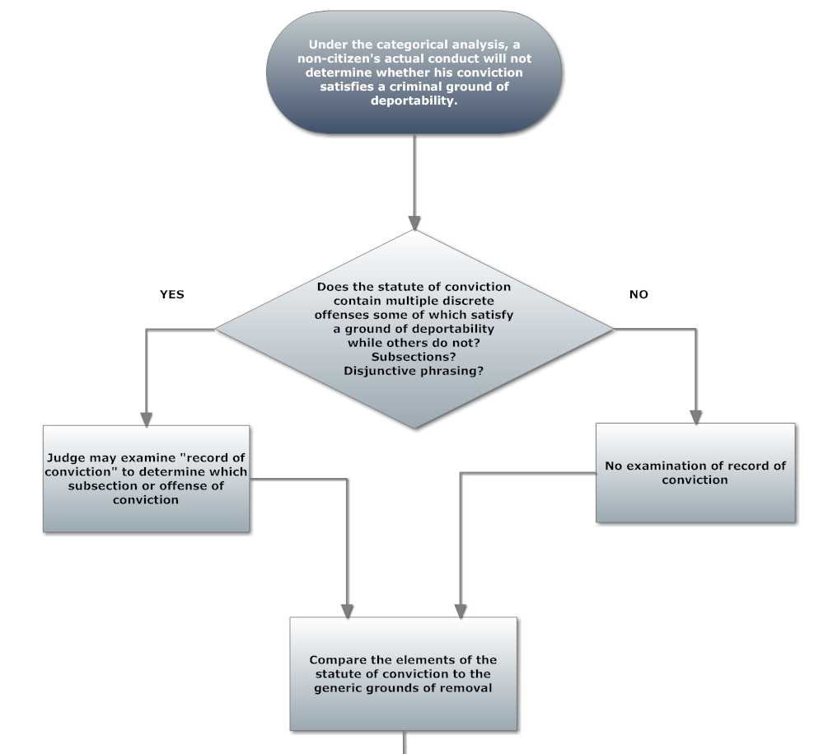
Notes:
This is a categorical analysis flow chart that walks you through how to evaluate whether your client is subject to deportation based on the conviction analyzing the state conviction.

Slide 90
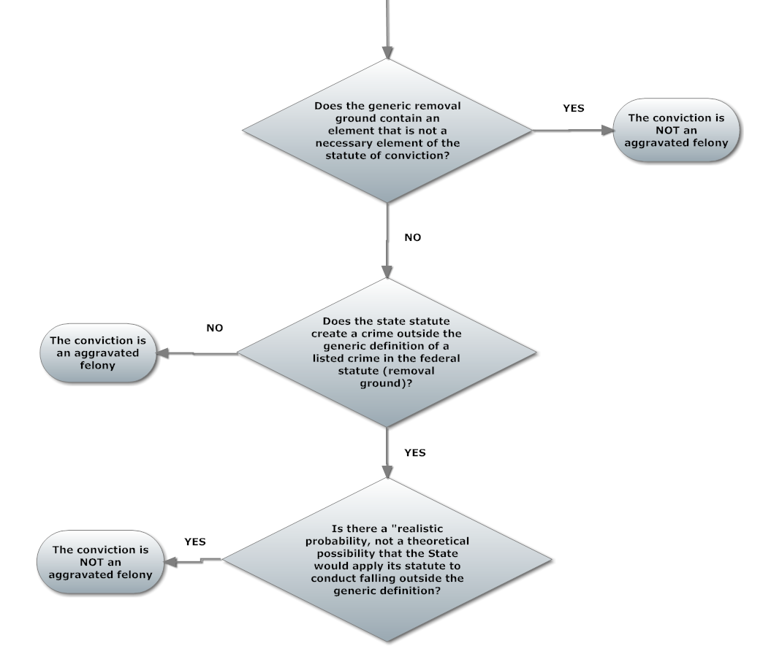

Slide 91
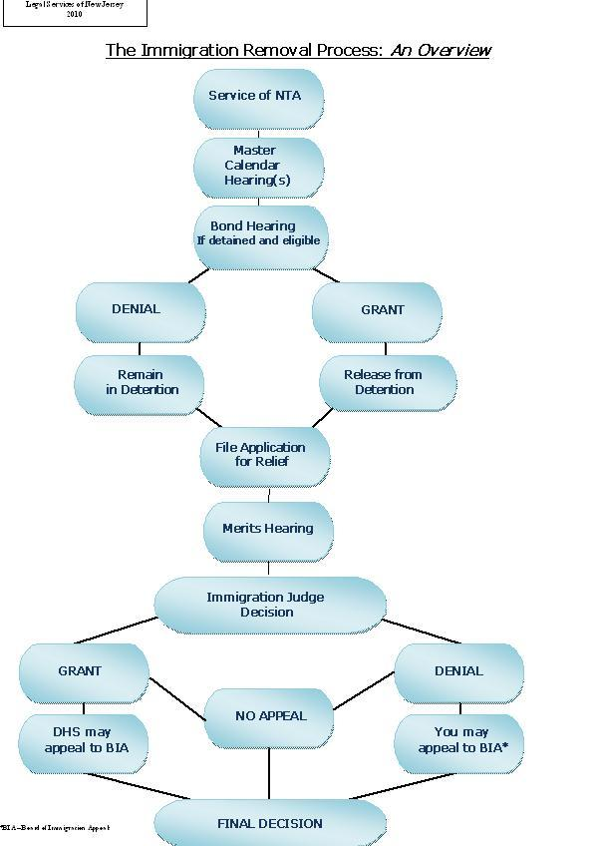

Slide 92




Questions and Answers
When?
How?
Who?
What?

